Slide 1

Project Demo
By: Rutuja Umakant More, CSE B.E (43062)
Under the Guidance of : Prof. K.V. Reddy

Slide 2
CONTENT
1] Introduction
2] Literature Review
3] Implementation
4] Screenshots

Slide 3
INTRODUCTION
Name of the Project: DC storage (DAPP)
DC Storage is a DAPP (Decentralized Application). It is cloud-like storage where one can access/retrieve, upload data or applications over the internet.
Blockchain storage costs can reduce the price of cloud computing. It not only handles storage but also protects and recovers and is transparent to users and also gives high security and privacy to data.

Slide 4


Slide 5
LITERATURE REVIEW
Blockchain platforms and languages for writing smart contracts are becoming increasingly popular. However, smart contracts and blockchain applications are developed through non-standard software life-cycles, in which, for instance, delivered applications can hardly be updated or bugs resolved by releasing a new version of the software.
So to create DAPP with the help of solidity which is an object-oriented, HLL (High-Level Language) on the Ethereum network for implementing smart contracts. Now Ganache is in the role where it is used to test DAPP in a safe environment means to add a smart contract on blockchain first it will go through ganache. Ganache is a tool used to set up an Ethereum network in this case DC storage is for testing solidity contracts.
To access DC storage through web browsers Reactjs is used, as react will communicate with blockchain through web3js.

Slide 6
IMPLEMENTATION
DC storage is a DAPP made through smart contracts.
This smart contracts are made using solidity programming language which is deployed on ethereum network.
Ganache is a tool which is used to test this DAPP in safe environment which provides us some fake ethers with an account.
Metamask is a extension which is used in browsers acts as a wallet where we can use our account by providing a private key.
Web3js is used to connect this blockchain network to UI of this DAPP which is made using reactjs

Slide 7
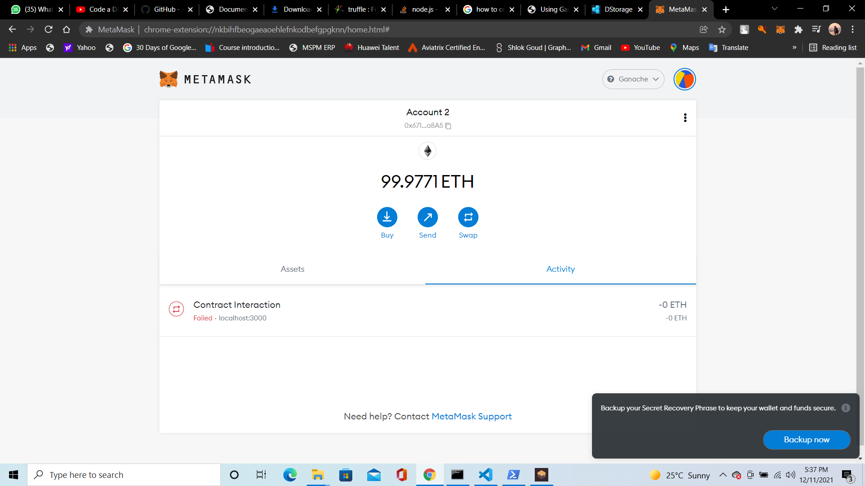

Slide 8
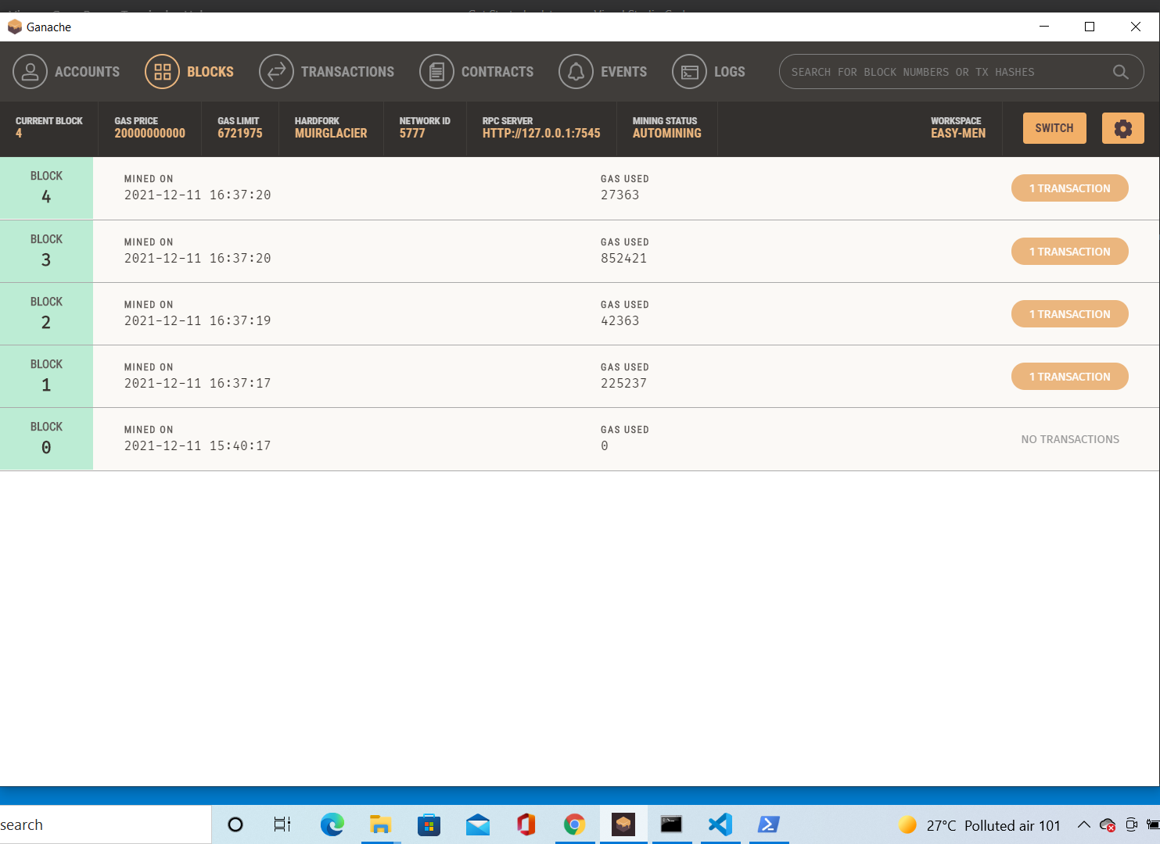

Slide 9
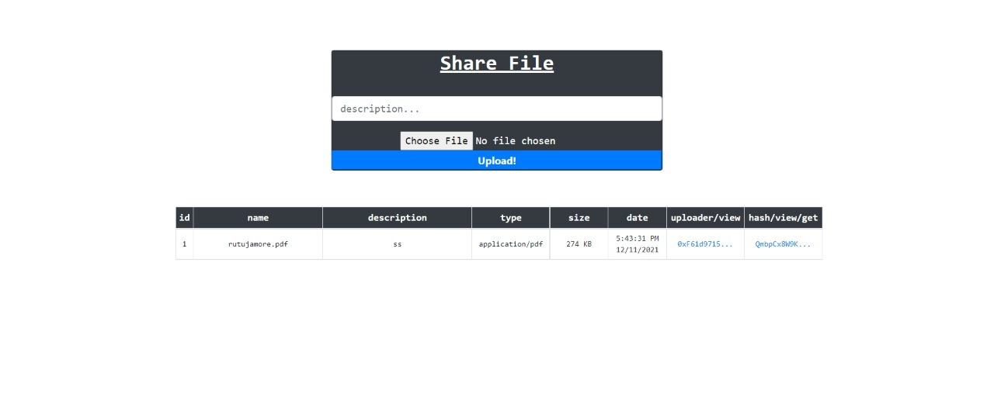
Project completion: 70%

